Slide 1
AUDIT ON DAY THEATRE UTILISATION
Dr N Shetty, Dr A Relwani
Darent Valley Hospital
Dartford, Kent

Slide 2
INTRODUCTION
Department of Health NHS Plan 2000 – 75% elective surgery should be performed as day case surgery
Day surgery theatres must be used optimally to achieve maximum day case rates and reduced inpatient waiting times

Slide 3
STANDARDS FOR BEST PRACTICE
90% theatre utilisation
Less than 10% lists should have utilisation of < 80%
Less than 10% lists should have utilisation of > 100%
100% of lists should start within 15 mins of planned start time
Less than 10% of lists should have an unplanned gap of > 10 min during the session

Slide 4
COMMOM REASONS FOR FAILURE TO REACH STANDARDS
Medical staff unavailable
Equipment shortages
Training issues
Failure of patient to attend
Cancellation of patients on the day of surgery

Slide 5
REASONS FOR AUDIT
Identify if day care theatre utilisation is upto standards
Implement steps to improve current practice and optimize utilisation to maximize theatre efficiency

Slide 6
METHODS
Prospective audit
February – March 2008
Audit proforma

Slide 7
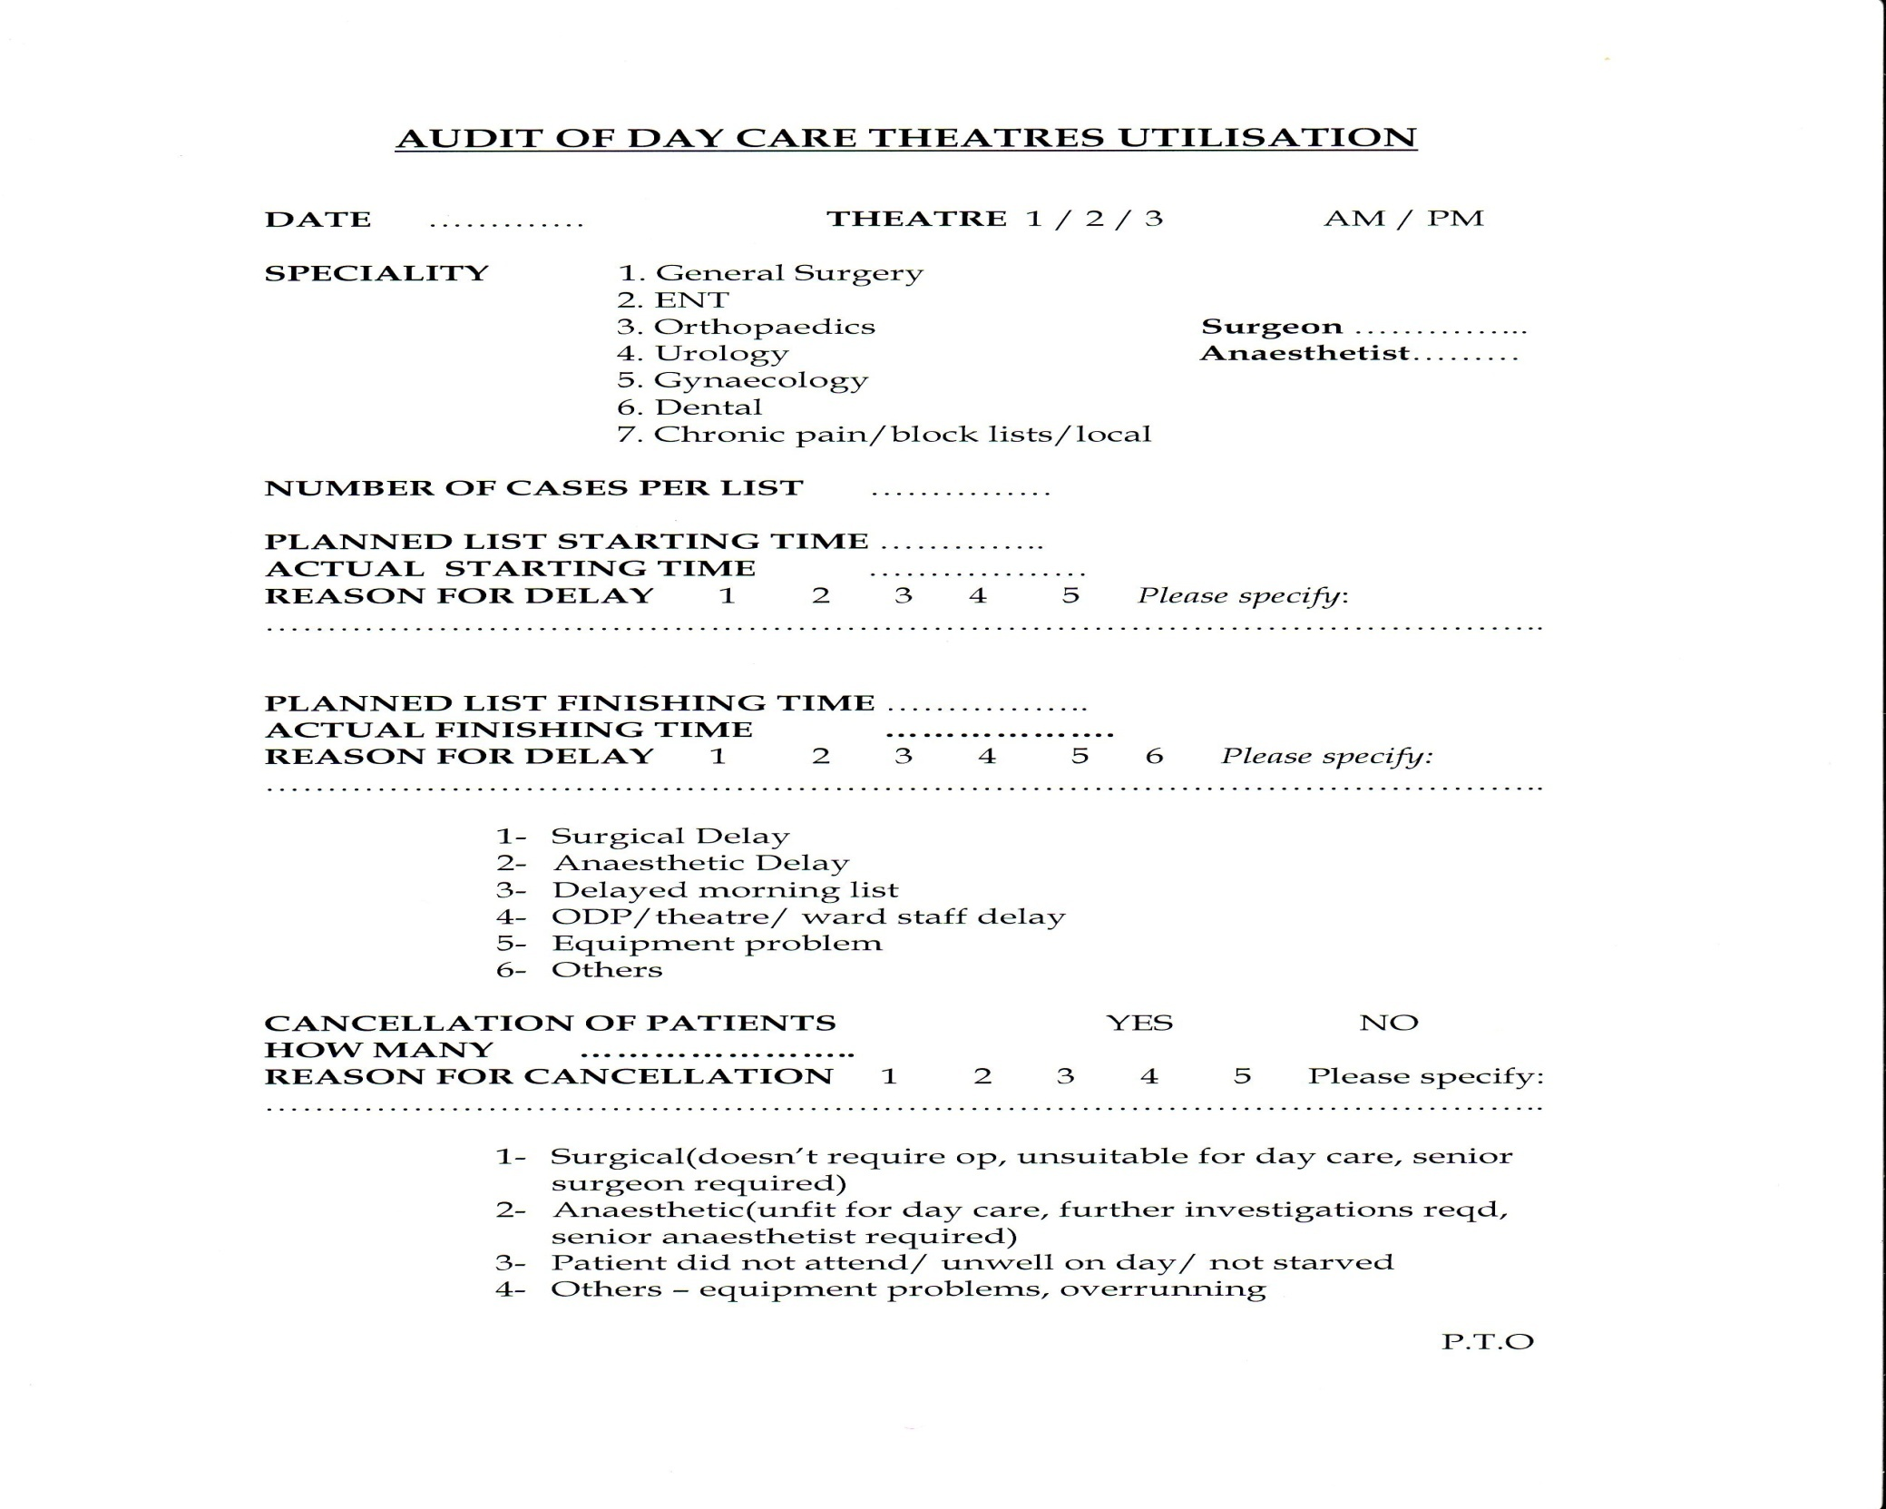

Slide 8
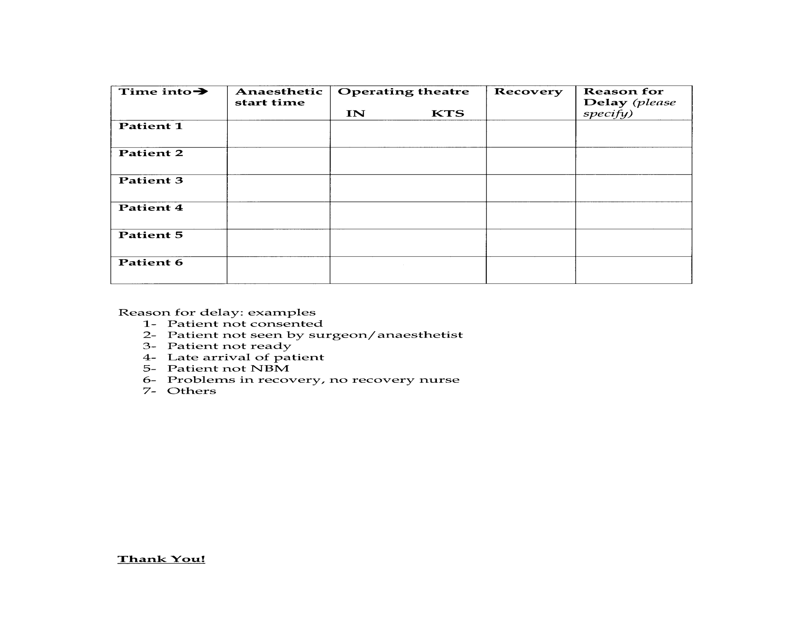

Slide 9
ALLOCATED THEATRE SESSIONS
Morning lists
Planned start time 09:00
Planned finish time 12:30
3.5hrs
Afternoon lists
Planned start time 13:30
Planned finish time 17:00
3.5hrs
179 sessions
- 95 morning
- 84 afternoon

Slide 10
MORNING SESSIONS - start time
95 sessions
12 - started early(earliest start 30minutes)
17 - started on time
66 - delayed starts(latest start 70 minutes)
25 within 15 mins
41 >15 mins
54 - started within 15minutes of scheduled start (57% vs RCoA standard of 100%)

Slide 11
Morning sessions start time
332.5 hours available
27 hours delay
8% of total available time
12 early starts
1.95hours gained

Slide 12
Reasons for late starts

Slide 13
Morning sessions end time
45 - early(15 mins-190mins)
- 11 started early
- 13 started on time
- 21 started late
6 - on time
39 overran(5mins-100mins), 36 following late starts
5 lists – not documented
45.25 hrs – time lost to early finishes
13.6% of total available
20 hrs - overrun time

Slide 14
AFTERNOON sessions START TIMES
84 sessions
3 early (earliest start 30 minutes)
11 on time
70 delayed starts (latest start 115 minutes)
18 within 15 mins
51 >15 mins
1 not documented
32 - started within 15minutes of scheduled start (38% vs RCoA standard of 100%)

Slide 15
AFTERNOON SESSIONS START TIMES
294 hours available
38.2 hours delay
12.9% of total available time
3 early starts
45 minutes gained

Slide 16
REASONS FOR late starts

Slide 17
AFTERNOON sessions END TIME
50 - early(5 mins-135mins)
- 2 started early
- 6 started on time
- 42 started late
10 - on time
18 - overran(10mins-85mins), 13 due to late starts
6 - not documented
37 hrs – lost to early finishes
12.7% of total available
11.5 hrs - overrun time

Slide 18
summary
136 late starts
65.2 hours lost
95 Early finishes
80.5 hours lost
15 early starts
2.7 hours gained
56 Over-runs
31.5 hours

Slide 19
utilisation
In total 626.5 hours of theatre time available
65 hours lost to late starts (10.3%)
80.5 hours lost to early finishes (12.8%)
Total time utilised 480.8 hours
Utilisation = 76.7%

Slide 20
Under utilisation
36 morning sessions with <80% utilisation – 37.9%
42 afternoon sessions with <80% utilisation – 50%
78 sessions <80% utilisation - 43.6%

Slide 21
gaps between patients
Morning sessions 8 with gaps >10mins
77 <10mins
10 not documented
Afternoon sessions 3 with gaps >10mins
72 <10mins
9 not documented
Gaps between patients in 6.1% vs <10% RCoA standard

Slide 22
CANCELLATIONS
77 sessions:
38 morning
39 afternoon
91 patients

Slide 23
CANCELLATIONS

Slide 24
results
Out of 626.5 hours of theatre time available, 65 hours lost to late starts and 80.5 hours to early finishes.
Total theatre time utilized 76.7 % (RCoA target 90%)
78 sessions (43.6%) had less than <80% utilization (RCoA <10%)
86 sessions (48%) started within 15 min of planned time (RCoA 100%)
Gaps between patients of > 10 min in 6.1% sessions (RCoA <10%)

Slide 25
conclusion
Main reasons for poor utilisation
+ Early finishes
+ Day of surgery cancellations
+ Late starts

Slide 26
recommendations
Better theatre planning and organization to enhance pt readiness for theatre
Theatre scheduling, minimize changes to order, letters with clear instructions, bed availability if needed(23 hr day surgery)
Early Finishes
+ Under utilised lists to be done fortnightly and alternate sessions to
specialities with waiting lists
Cancellations on Day of Surgery
+ Phone patients 72 hours prior to surgery
+ Efficient Preassessment Service:
Introduced Walk ins, Pt screening questionairre and Pt Information leaflets
Increased Consultant input in clinics (high risk pt preassessment )
High risk pts on specified lists

Slide 27
Late Starts
+Prompt starts
+Introduction of all day lists (more efficient)
Gaps Between Patients (Turnaround Time)
+Pt ready on ward in time
+Walk patients down
+Designated Recovery Nurses

Slide 28
THANK YOU

